Slide 1
ADOBE ANALYTICS CHALLENGE 2019
presented by Sai Nikhilesh Kasturi ,Venkata Sinjith Varma Kalidindi and Sandeep Pradeep Kumar

Slide 2
What are the key behaviors driving customers to MLB.com, Club.com and MLB At Bat Apps?
What opportunities are there for improvement?
Goal of this presentation is to evaluate MLB’s key behaviors for the season on basis of various metrics !!!

Slide 3
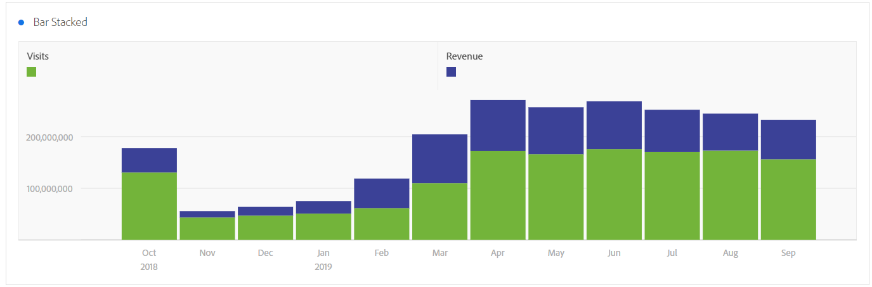
Based on the insights from the graph, we found that number of visitors and revenue decreased from November until February !!! Why ??
Because the Season ends in October and Starts in March !!!

Slide 4
RECOMMENDATIONS TO IMPROVE THE REVENUE AND FOOTTRAFFIC TO WEBSITE DURING THIS PERIOD
CREATE A LOYALTY PROGRAM
OFFER POPUP SALES
HOST EVENTS

Slide 5

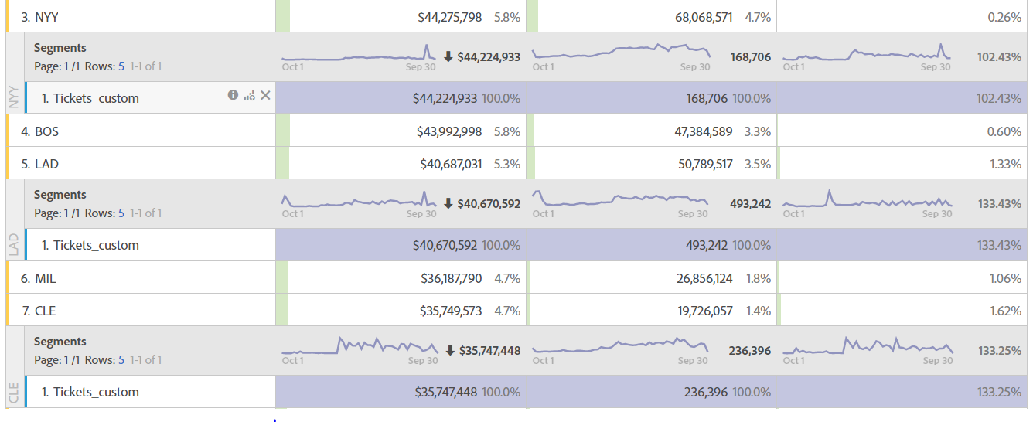
Though NYY has the highest revenue of all, it has a poor conversion rate when compared to LAD and CLE which have higher conversion rates .Why???
Notes:
New York Yankees have huge fan base, but their conversion rate is very low compared to Los Angeles Dodgers because of few factors which we have analysed.
Complex UI – New York Yankees have complex and slow UI compared to Los Angeles Dodgers
Ticket price
Combo Plans
Different types of Tickets plans

Slide 6
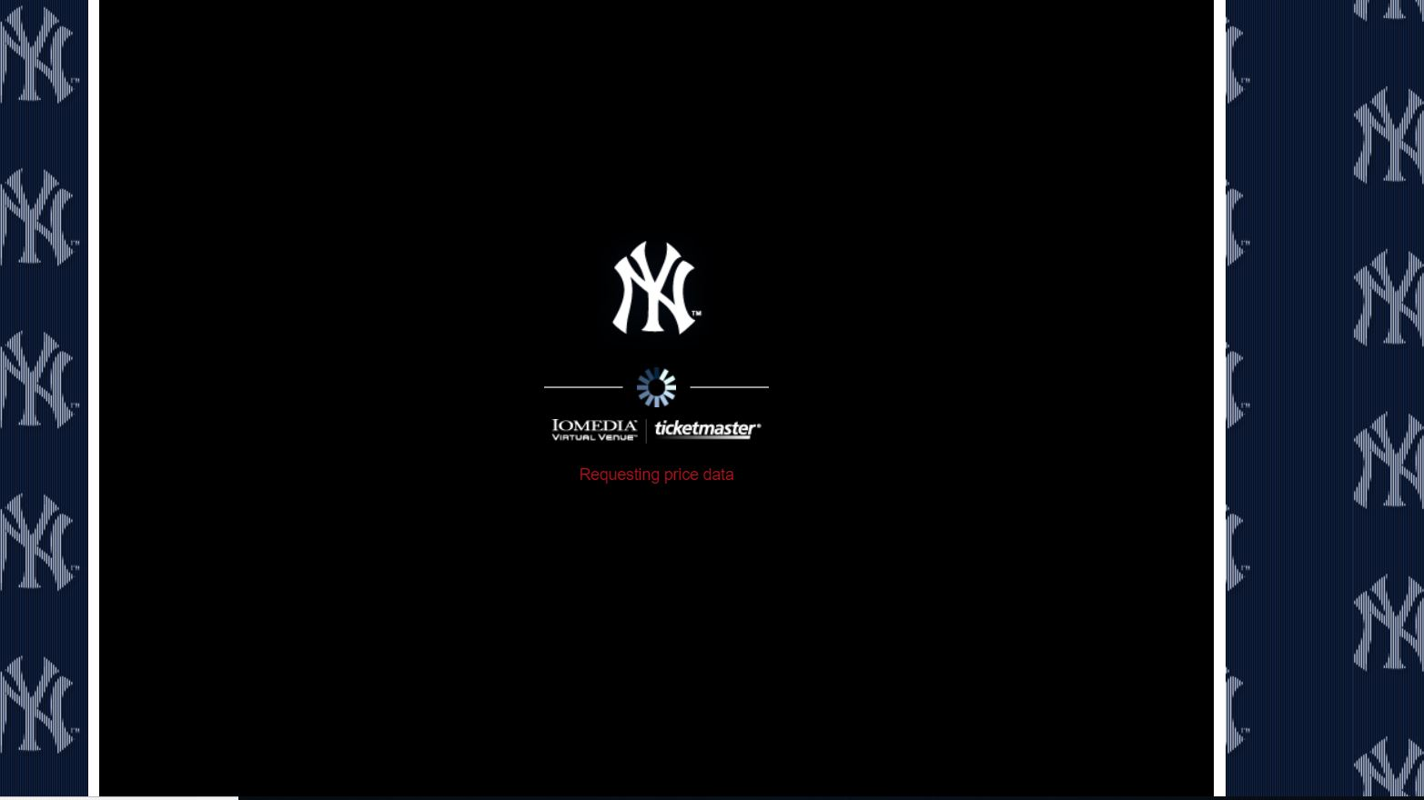
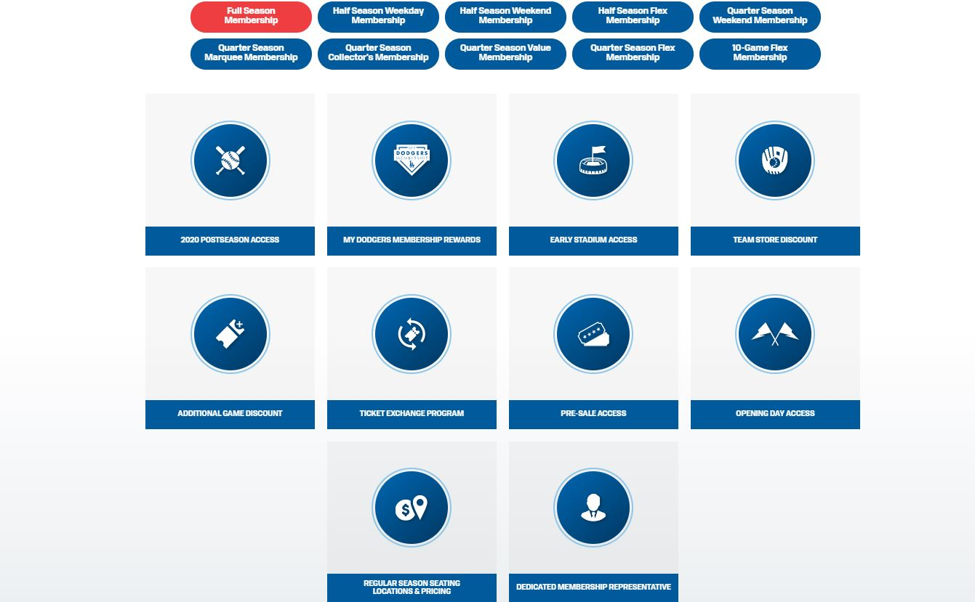
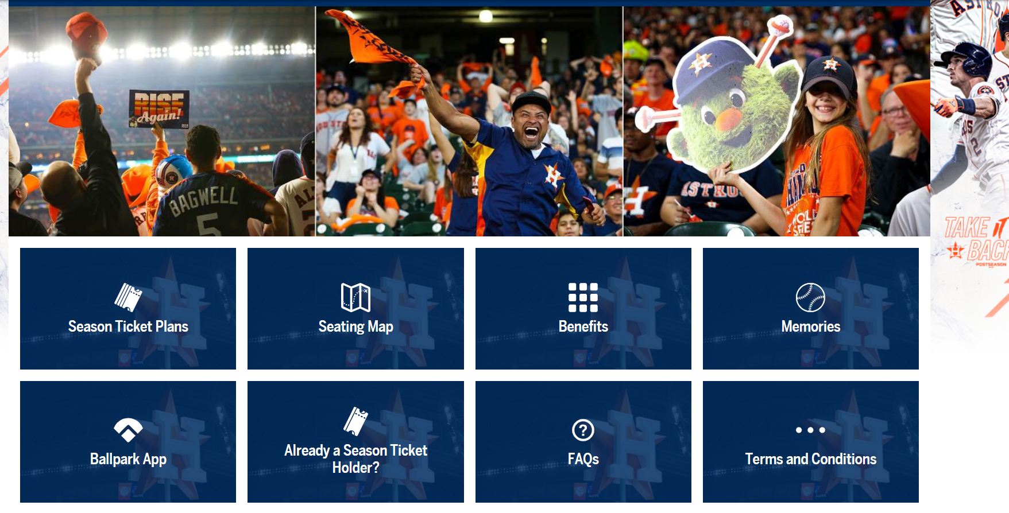
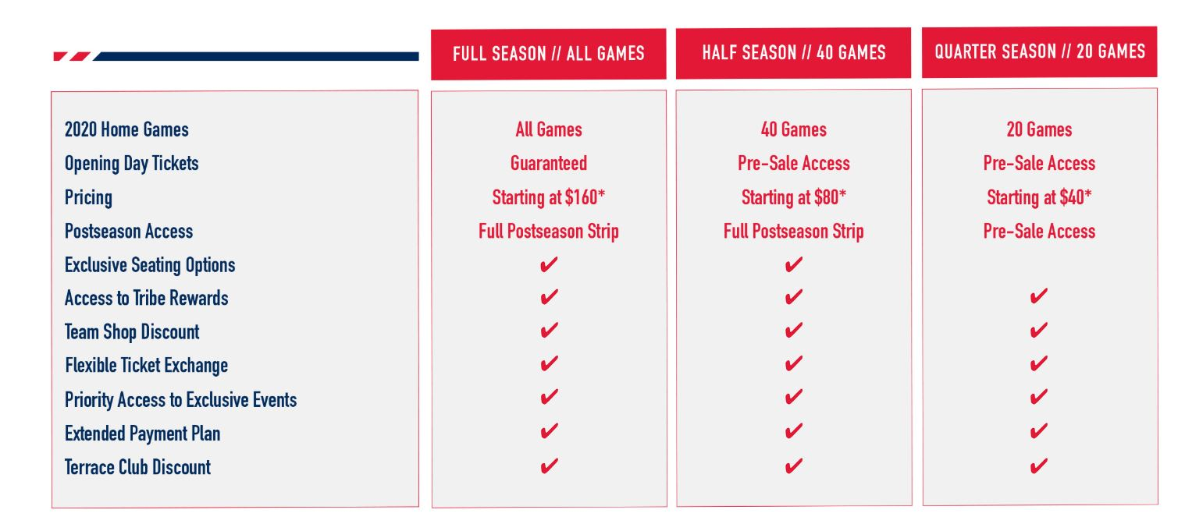
LOW CONVERSION RATE, COMPLEX UI
When you see the loading ticket page of each club, we can notice that the clubs with high conversion rates have simple and easy UI, good combo plans and comparisons of all plans.

Slide 7
KEY STATS
MLB STATS (Jan’19 – Sep’19)
March 31th : The date at which MLB reached 44.2 million visits, 235,982 orders mark in 2019 which is equivalent to 8% of total generated in that fiscal year.
10.91% : Year-over-year decrease in total sales.
61.4% : Unique visitor(321.7 M) in 2019 are from Mobile Phone.
13.9% : Natural search is biggest revenue generating marketing channel.

Slide 8
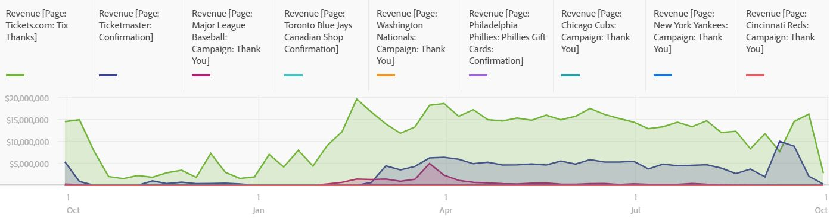
Important Pages by revenue
Tickets.com, Ticketmaster pages are more profitable compared to other pages in MLB pages
Recommendation: MLB must plan investing on referrer sites (tickets.com, ticketmaster) since these pages drive traffic and contribute to sales.

Slide 9
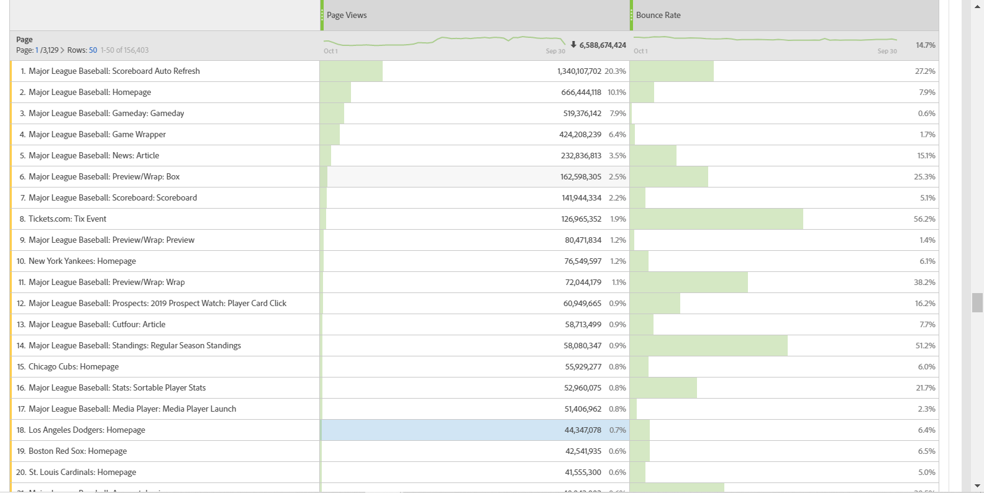
Bounce Rates for the Top viewed Pages
Notes:
As you can see from the graph, the bounce rate for Tickets.com is very high.
Recommendation : The ticketing page doesn't have any much information about the ticket prices. There should be redirecting path which can redirect to the club tickets page.

Slide 10
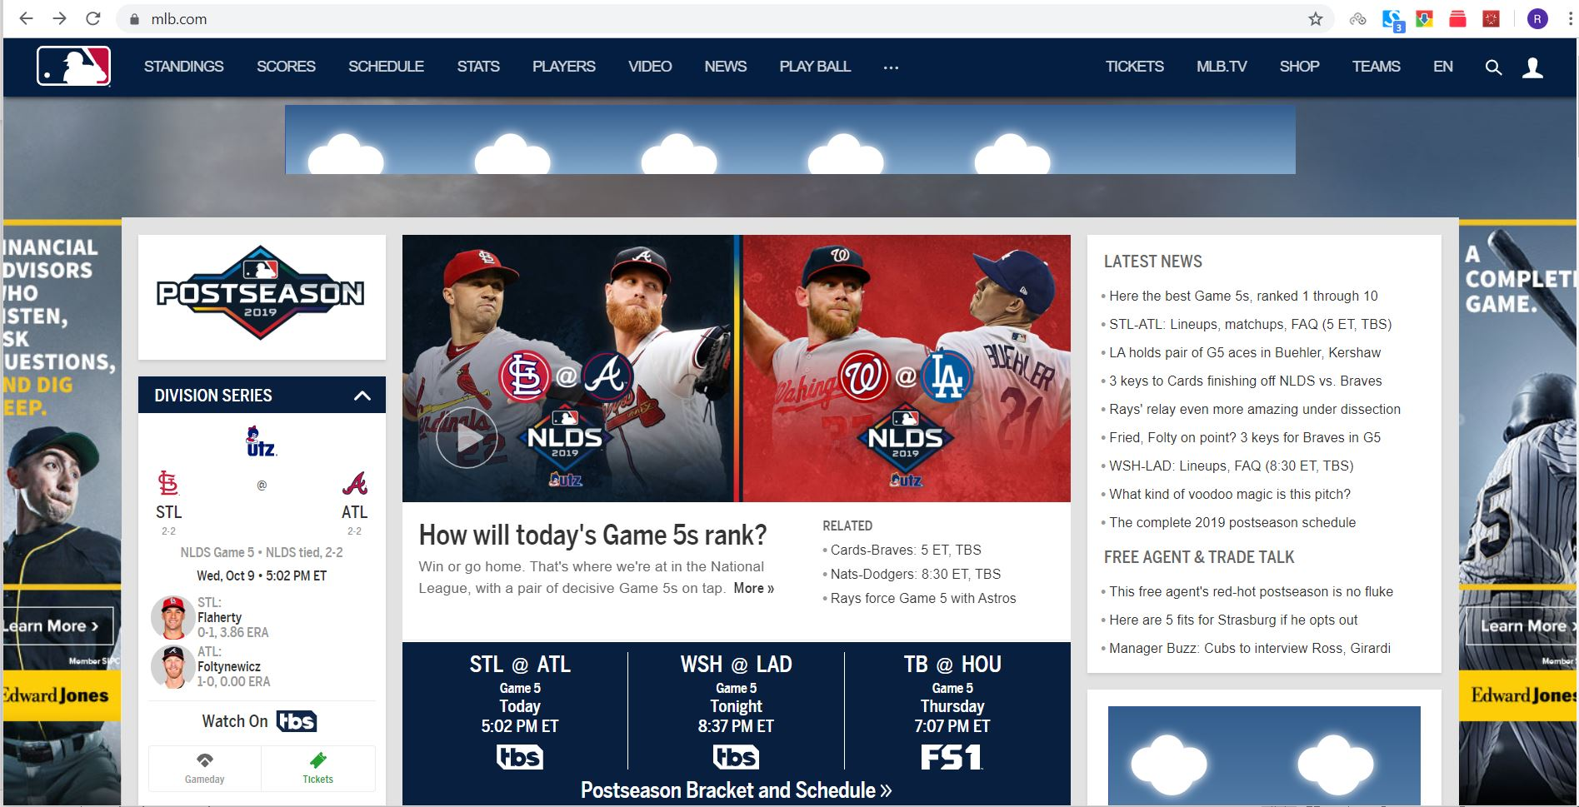
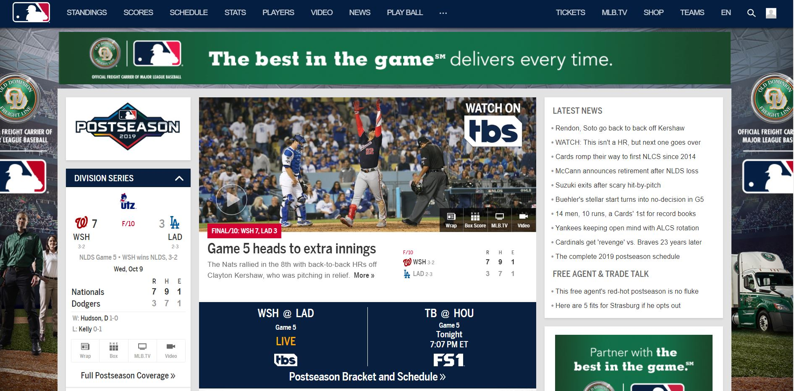
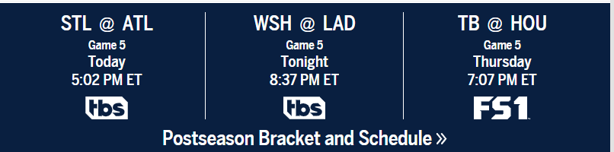
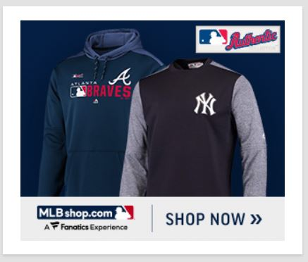
Recommendations to MLB website
As Ads are an important metric for revenue generation. We would like to recommend ads to be on the top of home page which can be seen and accessible to more fans.
Instead of static dashboard of matches shown on the right image, we can have rolling dashboards on top showing scores and schedules of the upcoming matches.

Slide 11
CONCLUSION
Concentrate on Advertisements on the website for promotion of services/ products since they have higher conversion rate.
MLB must plan investing on referrer sites (tickets.com, ticketmaster) since these pages drive traffic and contribute to sales.
For better ticket conversion rate for each club based on the data, we would recommend a simpler UI, combo food plans and various ticketing plans for the season.
The ticketing page doesn't have any much information about the ticket prices. There should be redirecting path which can redirect to each club’s ticketing page.

Slide 12
Thank you !!!

